Slide 1
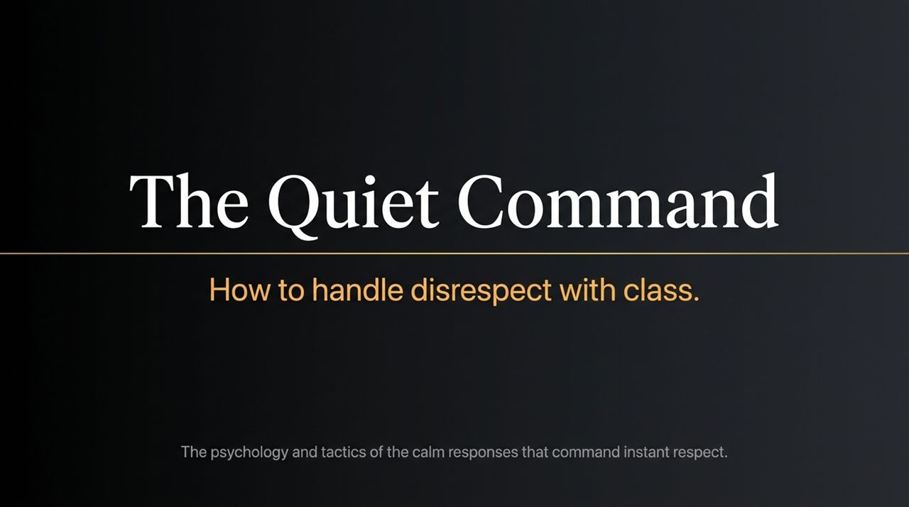
Notes:
Welcome, everyone. Today we are exploring a skill that is rarely taught explicitly, yet dictates your daily status, peace of mind, and personal power: The Quiet Command—How to handle disrespect with class.
Think about the last time someone threw a cutting remark your way, talked over you in a meeting, or made a passive-aggressive comment. In that moment, your chest tightens, your heart rate spikes, and your brain demands an immediate response.
As shown on this slide, most people fall into one of two default traps when disrespect occurs:
EXPLODE (Reacting): You snap back, raise your voice, or launch a comeback. The result? You hand them the remote control to your emotions—you dance to their rhythm.
SHRINK (Swallowing): You freeze, stay silent out of awkwardness, and swallow the insult. The result? You carry that insult for days like a stone in your pocket—a silent defeat.
Today, we examine The Calm Response. It is not passivity or being a doormat; it is a grounded, surgical, and composed way of taking back total control while leaving the aggressor holding their own aggression. Over the next 15 slides, we will unpack the psychology and tactics behind making yourself emotionally untouchable.
How to Handle Disrespect With Class: The Calm Responses That Command Instant Respect | Audiobook
https://www.youtube.com/watch?v=bCOfpEekn78

Slide 2
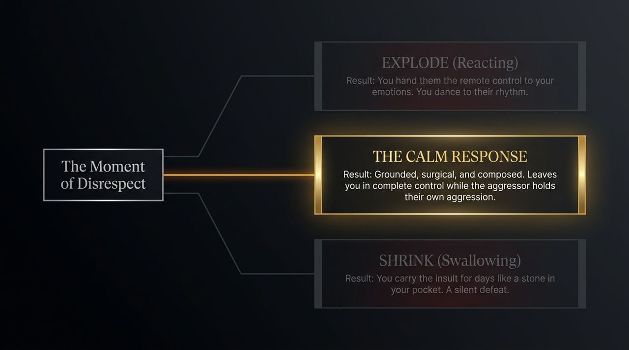
Notes:
To handle disrespect calmly, you must first understand what it actually is. Look at the Iceberg model on Slide 2.
Above the waterline, at the SURFACE, we see the overt actions: sarcasm, public put-downs, passive-aggressive digs, or people talking right over you. Most people focus entirely on the surface and take it personally.
But look below the waterline—at the SUB-SURFACE. What is disrespect in reality? It is a leak. It is a desperate bid for an emotional reaction. It is a symptom of internal insecurity, feeling powerless, or reacting to unagreed-upon expectations.
Here is The Core Insight: Disrespect is a reflexive attempt to regain control. It is a confession about the person who threw it, not an accurate report on your value. When someone insults you, they are broadcasting their own need for a spectacle. Once you realize their attack is an admission of weakness, taking it personally becomes almost impossible.

Slide 3
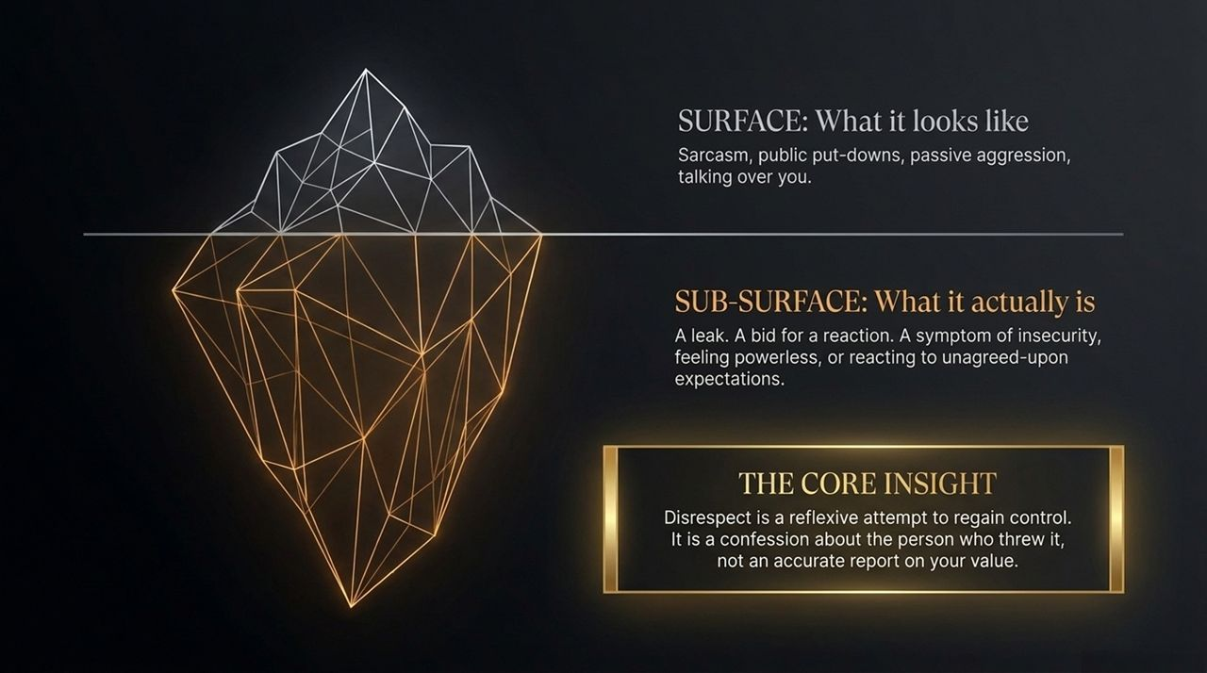
Notes:
When social disrespect strikes, your body treats it as a physical survival threat. Stress chemicals flood your bloodstream, your heart rate spikes, and your ability to articulate clear, logical thoughts collapses. This is why quick comebacks often turn into sloppy arguments.
The single most powerful tactic in high-stakes communication is The 3-4 Second Pause.
What does those 3 to 4 seconds of stillness accomplish?
The Neurological Advantage: It gives your prefrontal cortex—the rational, strategic brain—time to come back online, overriding the primitive amygdala hijack.
The Social Message: It sends a clear signal that you refuse their invitation to fight on their terms. It breaks the expected rhythm of immediate conflict.
Silence, when used intentionally, creates leverage. It transforms a chaotic stimulus into a clear-headed, deliberate, and unhurried response.

Slide 4
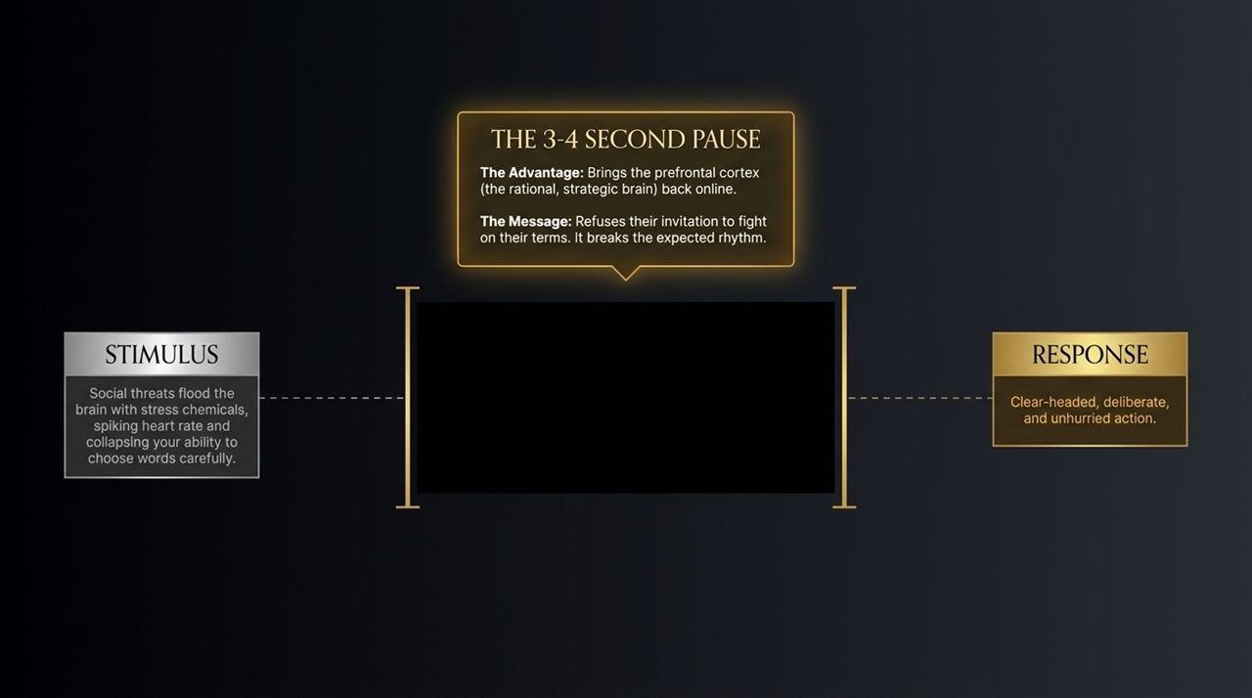
Notes:
Your words mean very little if your physiology betrays your agitation. Slide 4 gives us the Anchor Matrix across five core dimensions:
THE MIND (Internal Narration): Silently state: 'I am choosing how to respond.' This pulls you out of emotional panic and into the role of an objective observer.
THE FACE (Neutrality): Keep an unhurried expression with an unclenched jaw. Avoid micro-expressions of contempt or anger.
THE VOICE (Register): Speak in a lower pitch at a slower pace and steady volume. Crucially, let silence hang after you speak.
THE WORDS (Precision): Use specific, grounded language and totally eliminate emotional absolutes like 'always' or 'never'.
THE BODY (Anchors): Drop your shoulders, unclench your hands, and press both feet firmly into the floor.
When your body is anchored, your mind remains steady, forcing the other person to adjust to your baseline rather than pulling you into theirs.

Slide 5
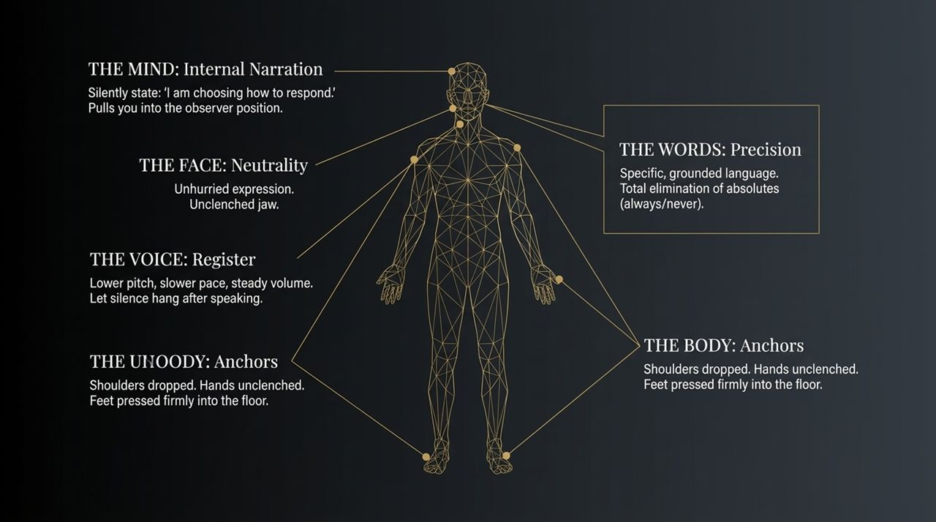
Notes:
Not all disrespect requires the same response. Applying a sledgehammer to a minor mistake damages relationships, while ignoring deliberate public attacks destroys boundaries. Slide 5 categorizes disrespect along two axes: Careless vs. Deliberate and Private vs. Public.
Careless / Private (e.g., A tired coworker snapping): Brief, calm acknowledgment. Let it pass unremarked—do not waste energy on tiredness.
Careless / Public (e.g., A clumsy family joke at dinner): Light deflection with a clean, unbothered change of subject.
Deliberate / Private (e.g., A partner's cutting remark): Clear, firm boundary: 'That was hurtful; I don't want us speaking that way.'
Deliberate / Public (e.g., A boss humiliating you in a meeting): Minimal composed acknowledgment in the moment ('Understood'), followed by a serious private follow-up.
Matching the tactic to the intent keeps you proportional, fair, and in command.

Slide 6
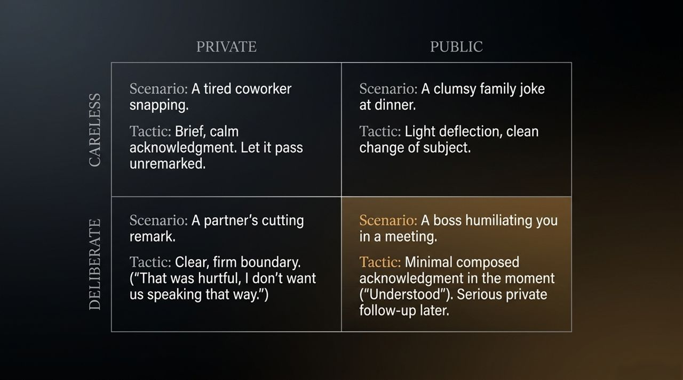
Notes:
Let's turn to workplace dynamics. In professional environments, disrespect usually takes two forms: peer competition or authority power plays.
1. Handling THE PEER (Interrupters, credit-takers, condescension):
The Script: 'I wasn't finished; I'd like to complete my thought.'
The Strategy: Reclaim space without drama. A short, composed line builds a reputation for steadiness under pressure far better than a lengthy defense.
2. Handling THE AUTHORITY (Public criticism, micromanagement):
The Script (In the moment): 'Understood, I'll take a look at that.'
The Script (In private): 'I'm open to correction, but I'd appreciate it being addressed privately.'
The Strategy: Separate the delivery from the content. Protect your livelihood publicly while asserting your dignity privately.

Slide 7
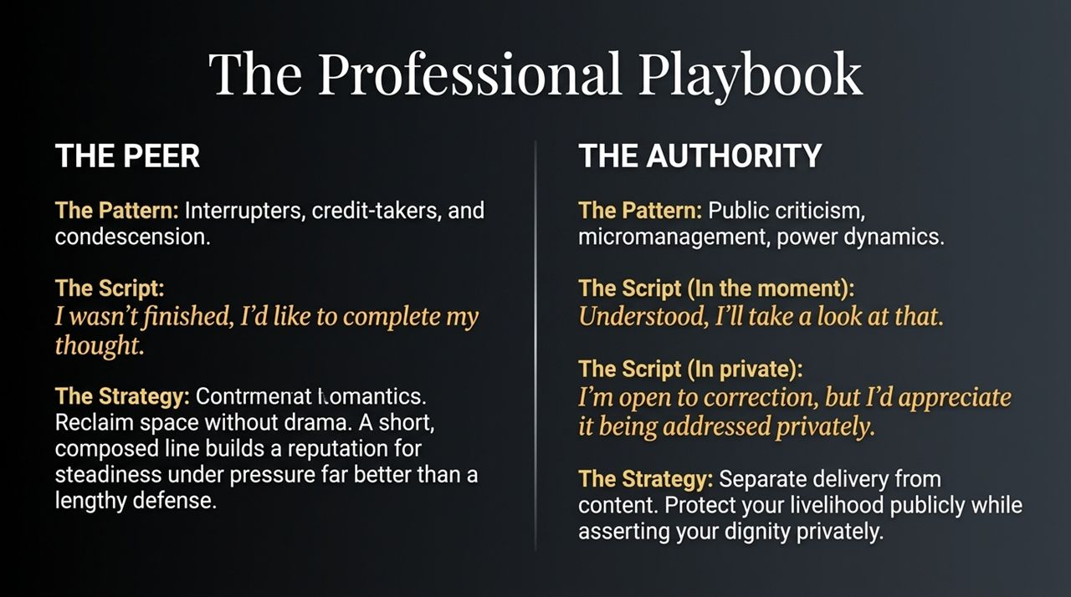
Notes:
Handling disrespect with loved ones is often harder than handling it with colleagues because of deep emotional ties.
FAMILY (Decades of grooved patterns):
The Script: 'I know you care, but I'm moving forward with my choice.'
The Strategy: Validate the underlying intent but firmly reject the judgment. Retraining decades of family history requires extreme, repeated patience and consistent boundaries.
PARTNERS (High-stakes intimacy):
The Script: 'That comment was hurtful, and I don't want us speaking to each other that way.'
The Strategy: Address the pattern directly without shouting. Remember: Calm boundaries do not destroy intimacy; they are the exact prerequisite for long-term trust.

Slide 8
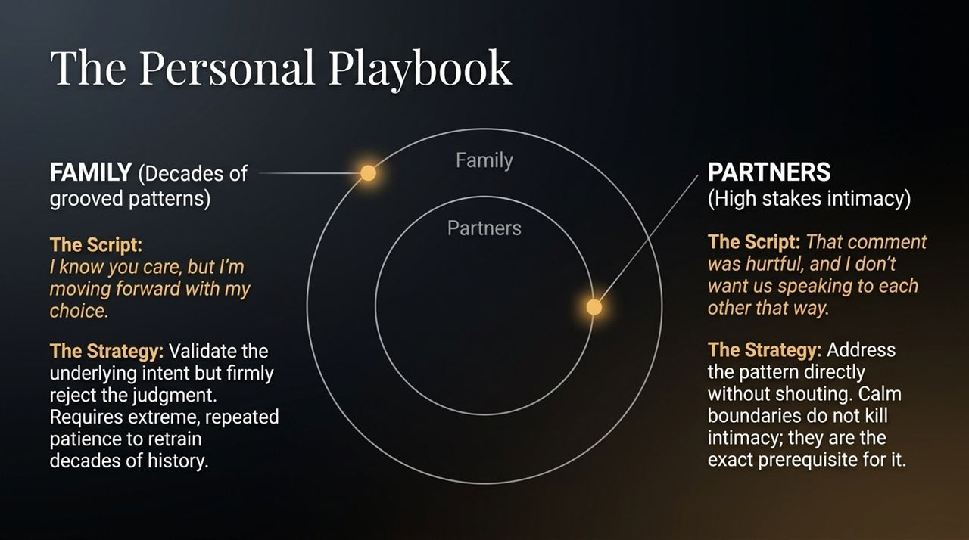
Notes:
Slide 8 tackles low-stakes, high-friction environments: strangers and social media.
THE STRANGER (Road rage, retail friction):
The Script: 'Interesting that you felt the need to say that out loud.'
The Insight: Your calm is for you, not them. Refuse to let a stranger with a bad personality rent space in your head for the rest of the day.
THE SCREEN (Online pile-ons, comment sections):
The Tactic: The delayed response—or better yet, the non-response.
The Insight: Algorithms profit from your outrage and emotional reaction. The ultimate power move online is declining to provide the spectacle they are hunting for.

Slide 9
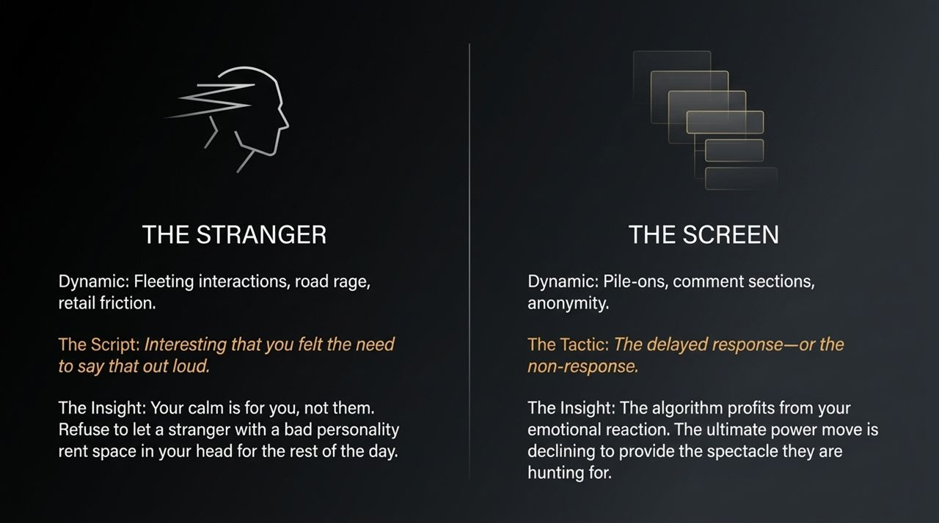
Notes:
Public humiliation triggers an evolutionary alarm—it feels like a survival threat. But modern social friction is not a physical threat. Your nervous system is simply firing an outdated alarm.
The Redirect: Deliver a simple line: 'Well, that was unexpected.' Then immediately and seamlessly return to the prior task.
The Reality of the Room: When someone tries to humiliate you publicly, the audience is usually uncomfortable and secretly on your side. Your calm resolves the room's tension and earns their quiet respect. The speed of your recovery matters just as much as the words you choose.

Slide 10
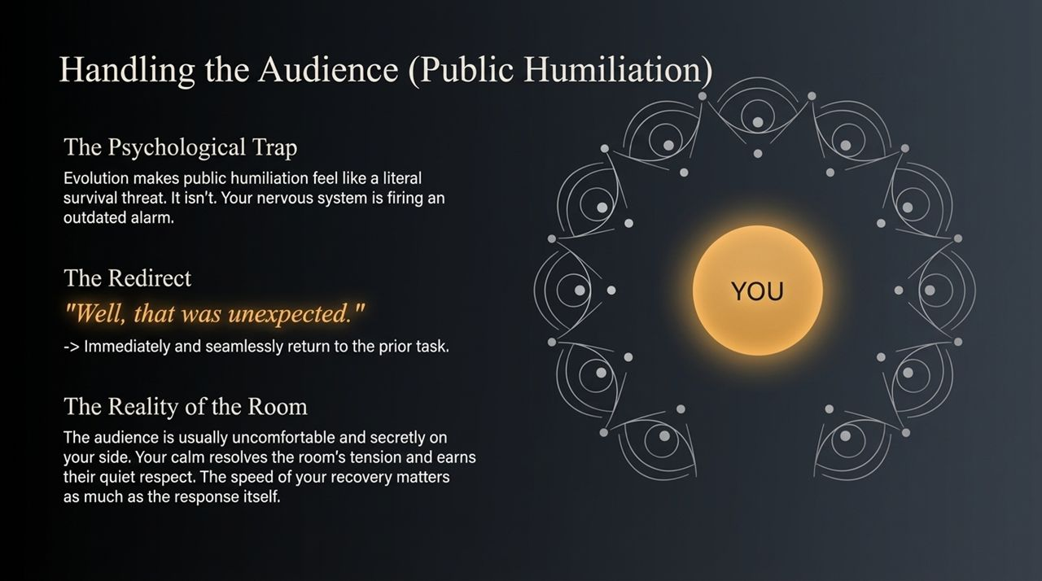
Notes:
We must draw a clear line between verbal disrespect and physical threat.
AMBER ZONE (Friction): Snapping, sarcasm, rudeness. Your goal is composure and setting firm boundaries.
RED ZONE (Aggression): Raised voices, physical intimidation, loss of self-control.
THE TACTICAL SHIFT IN THE RED ZONE:
When safety is threatened, your priority shifts entirely from grace to physical safety and de-escalation. Keep your hands visible, step back to maintain physical distance, consciously slow your breathing, and do not match their volume.
Deliver the ultimate boundary: 'I'm going to step away now.' Walking away from genuine aggression is not weakness; it is tactical awareness.

Slide 11
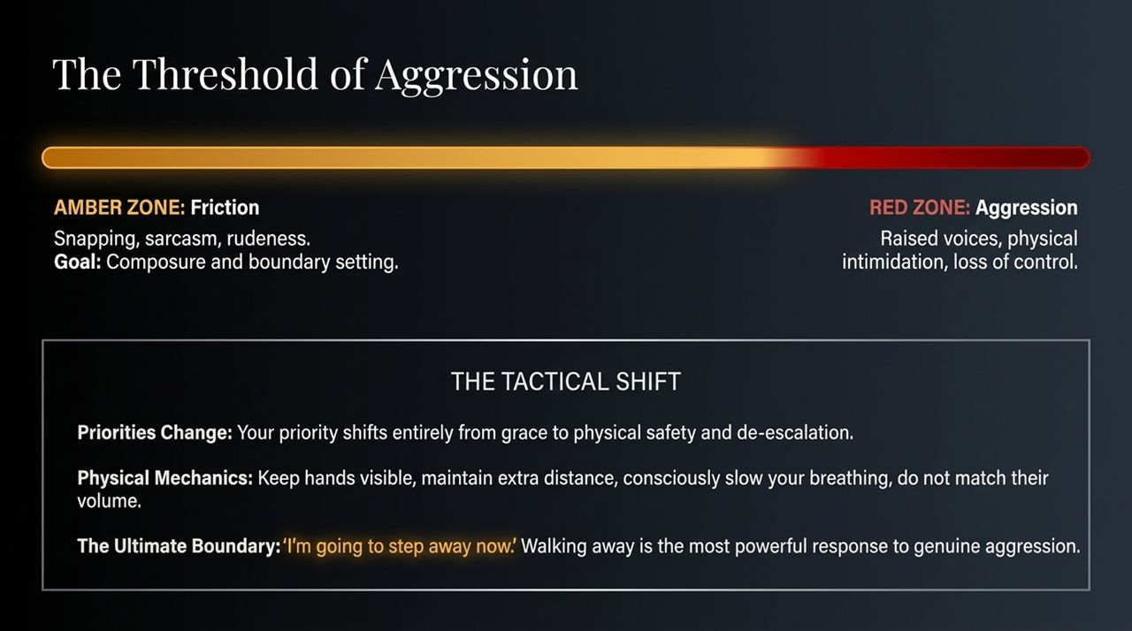
Notes:
How you handle disrespect impacts more than just the immediate interaction—it sets a standard for everyone watching.
Center Ripple (Modeling Behavior): When disrespected in front of children, mentees, or a team, you are teaching a live masterclass in self-control.
Middle Ripple (The Unspoken Standard): Teams and families naturally adopt the emotional tone of their leaders. Consistent calmness makes disrespect rarer overall.
Outer Ripple (The Intentional Debrief): Lock in the lesson later by stating: 'That person was speaking disrespectfully, and I chose to stay calm because that's how I want to handle hard moments.'

Slide 12
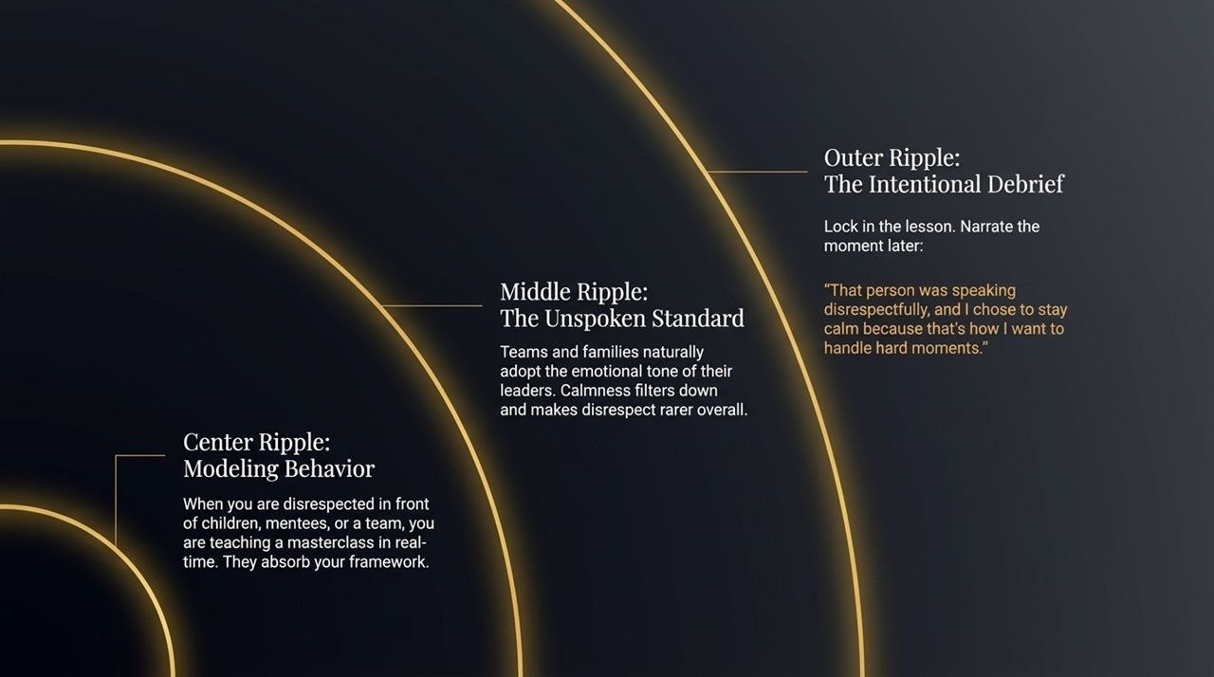
Notes:
Slide 12 brings us to the ultimate shift: Becoming Untouchable.
Handling disrespect with calm begins as a conscious, effortful performance. But over time, as you practice the pause, lower your vocal pitch, and enforce boundaries, it becomes your natural baseline identity.
The Ultimate Truth: Your core worth does not fluctuate based on someone else's worst moment.
People who handle disrespect calmly naturally attract less of it over time. Why? Because provokers want quick emotional reactions. When you consistently decline to supply that reaction, you become an uninteresting target for cheap drama.

Slide 13
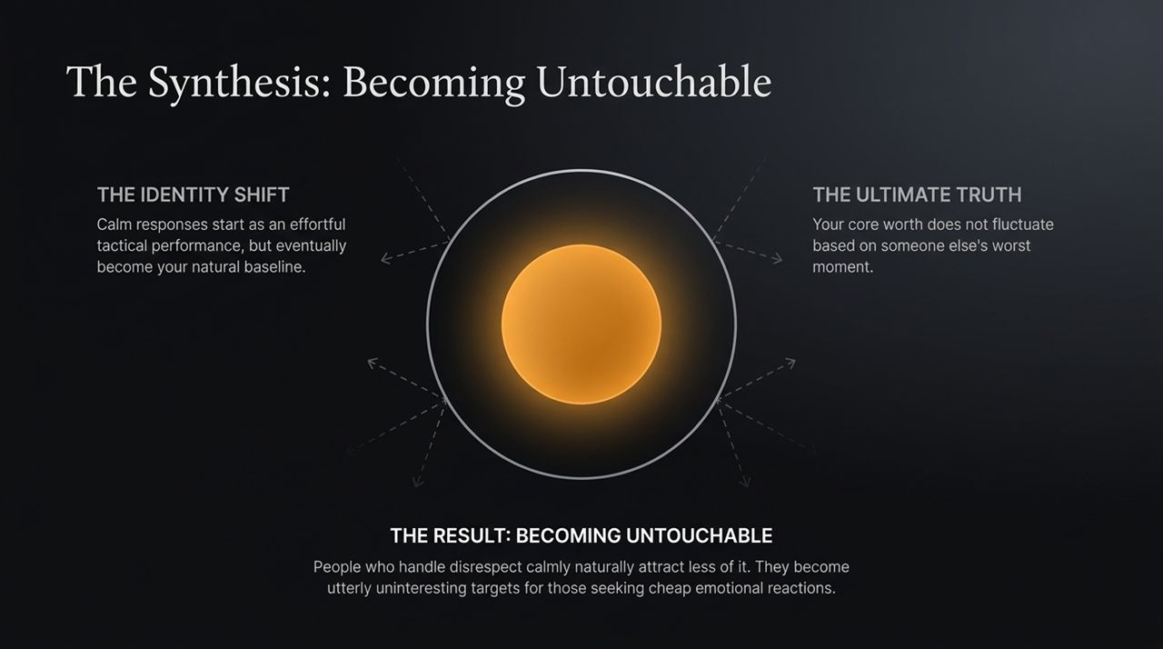
Notes:
Here is your operational cheat sheet for rapid mental retrieval:
THE MINDSET: Disrespect is a bid for a reaction. It is a confession about them, not a verdict on you. Your calm is for your own peace.
THE BODY: Press feet into the floor, drop your shoulders, unclench your jaw, and lower your vocal pitch.
THE TACTICS: Pause for 3–4 seconds. Deliver a short, clear boundary without absolutes, and tolerate the silence that follows.
THE ULTIMATE GOAL: Protect your peace, refuse the invitation to fight on their terms, and become someone whose worth is never up for debate.

Slide 14
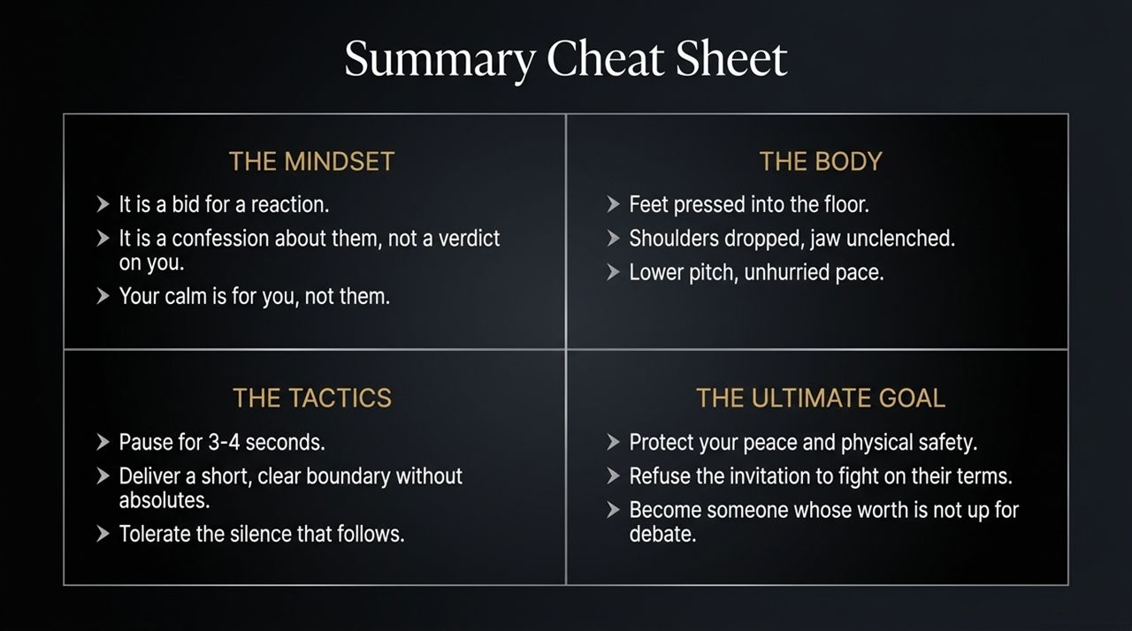
Notes:
Looking at Slide 14, let's lock in these core mechanics:
The Pause Reclaims Strategic Brain Function: 3 to 4 seconds lowers stress chemicals and restores clear thinking.
Disrespect Reflects the Provoker: Rudeness stems from internal insecurity, stress, or attempts to gain quick leverage.
Control Vocal Pace and Physical Posture: Slow, steady speech signals complete composure and strength.
Use Concise Boundaries: Brief statements leave the provoker's aggression hanging without adding emotional fuel.

Slide 15
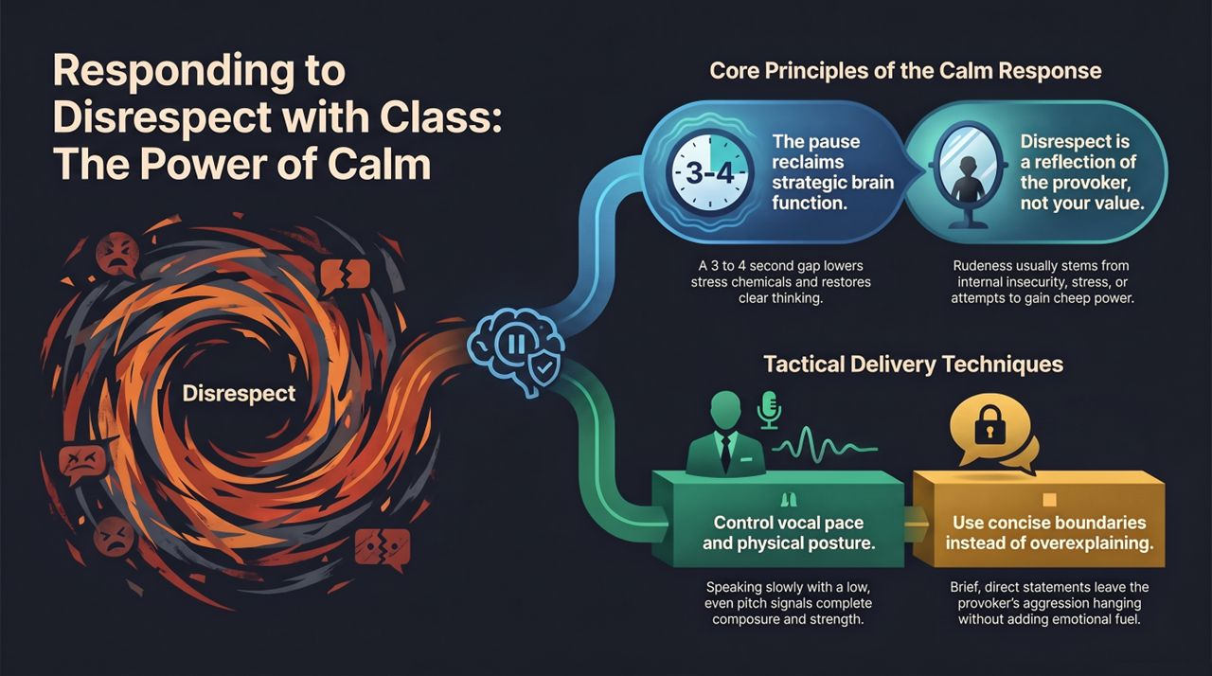
Notes:
To conclude our presentation, let me share three daily habits to make this framework second nature:
Practice the Pause in Low-Stakes Moments: Practice waiting 3 seconds before responding to simple texts, emails, or minor interruptions.
Conduct an Evening Mental Review: If you faced friction today, review how you responded without judgment. Ask: Did I explode, shrink, or execute a calm boundary?
Reframe Friction as Training: View disrespectful comments not as personal attacks, but as live practice sessions to strengthen your self-control.
Remember: True power is not about shouting the loudest or having the last word. True power is the quiet command of your own mind and body. Thank you.

